Slide 1
Lessons Learned from Working Remotely
Kansas City Developer Conference
June 26, 2015
Michael Eaton / @mjeaton

Slide 2































Titanium Sponsors
Platinum Sponsors
Gold Sponsors

Slide 3

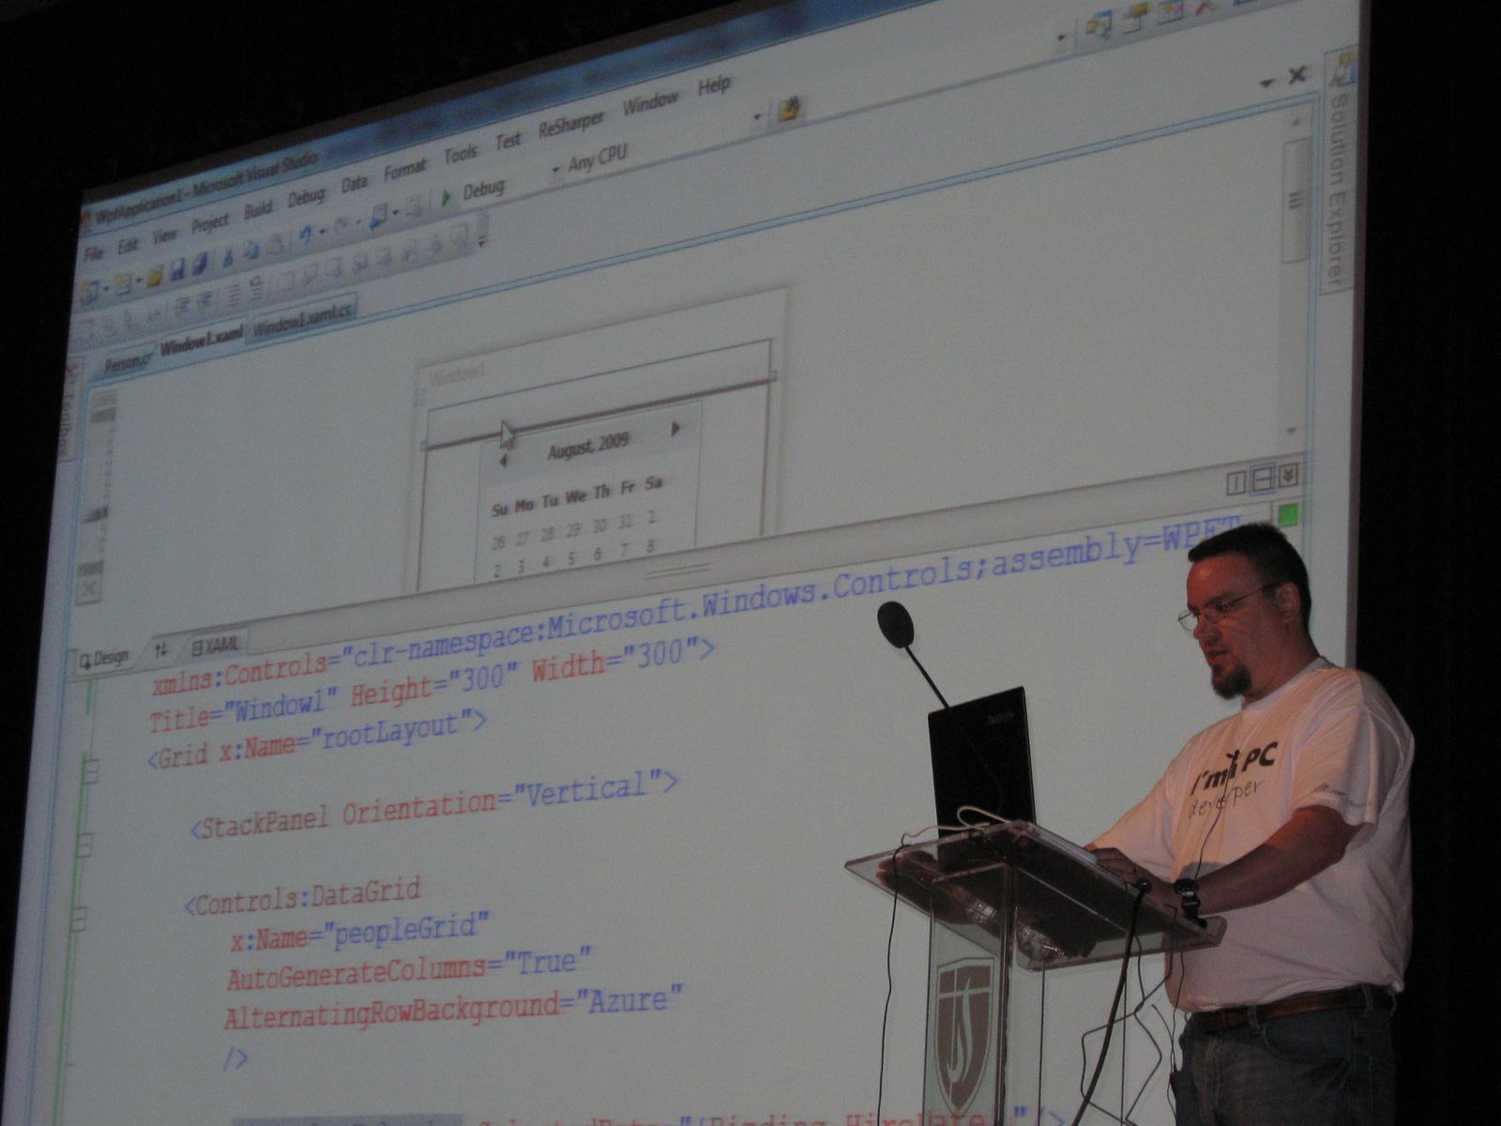
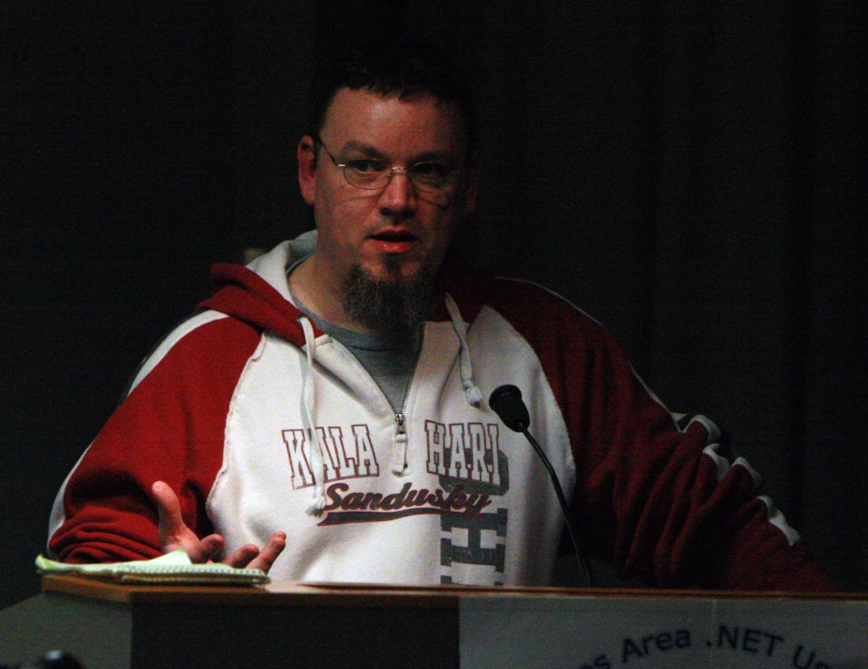
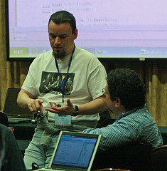

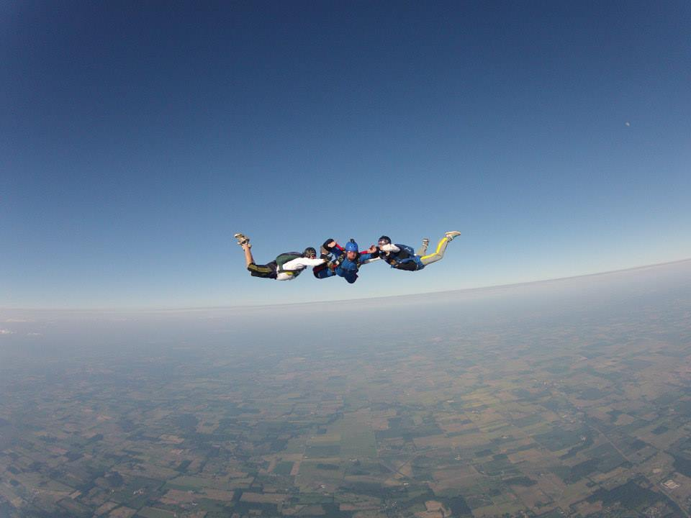

Slide 4

#1 Place to work in IT for the 3rd year in a row! http://bit.ly/quickenLoans1
We’re hiring! Interested? Let me know! @mjeaton / mikeeaton@quickenloans.com

Slide 5
about.me/mjeaton
Notes:
About.me/mjeaton

Slide 6


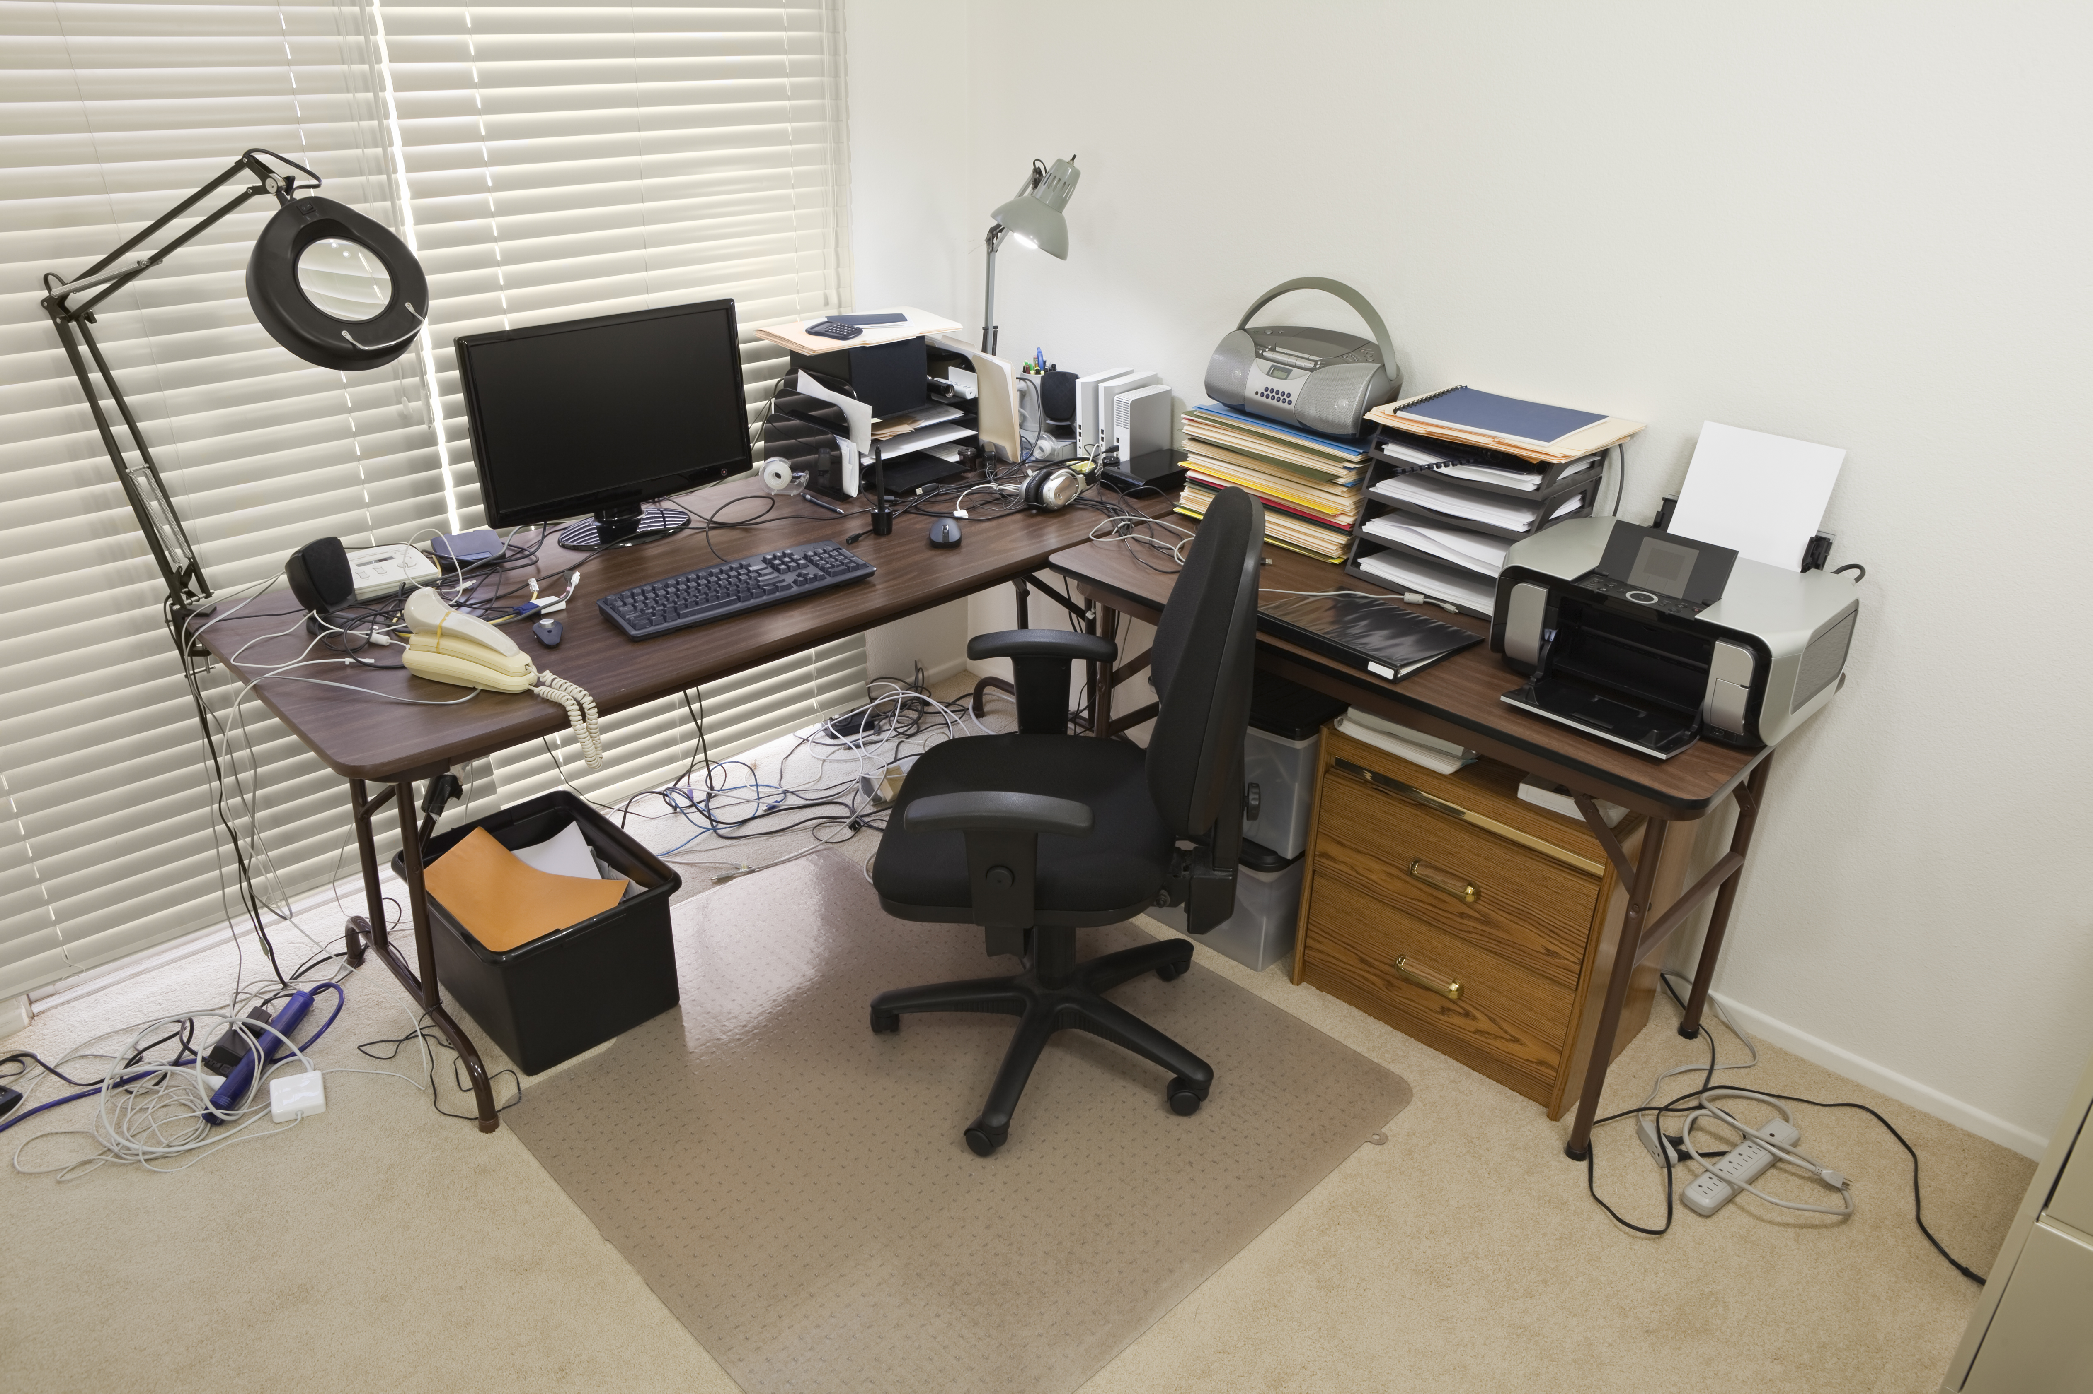
what is remote working?

Slide 7


what is remote working?

Slide 8
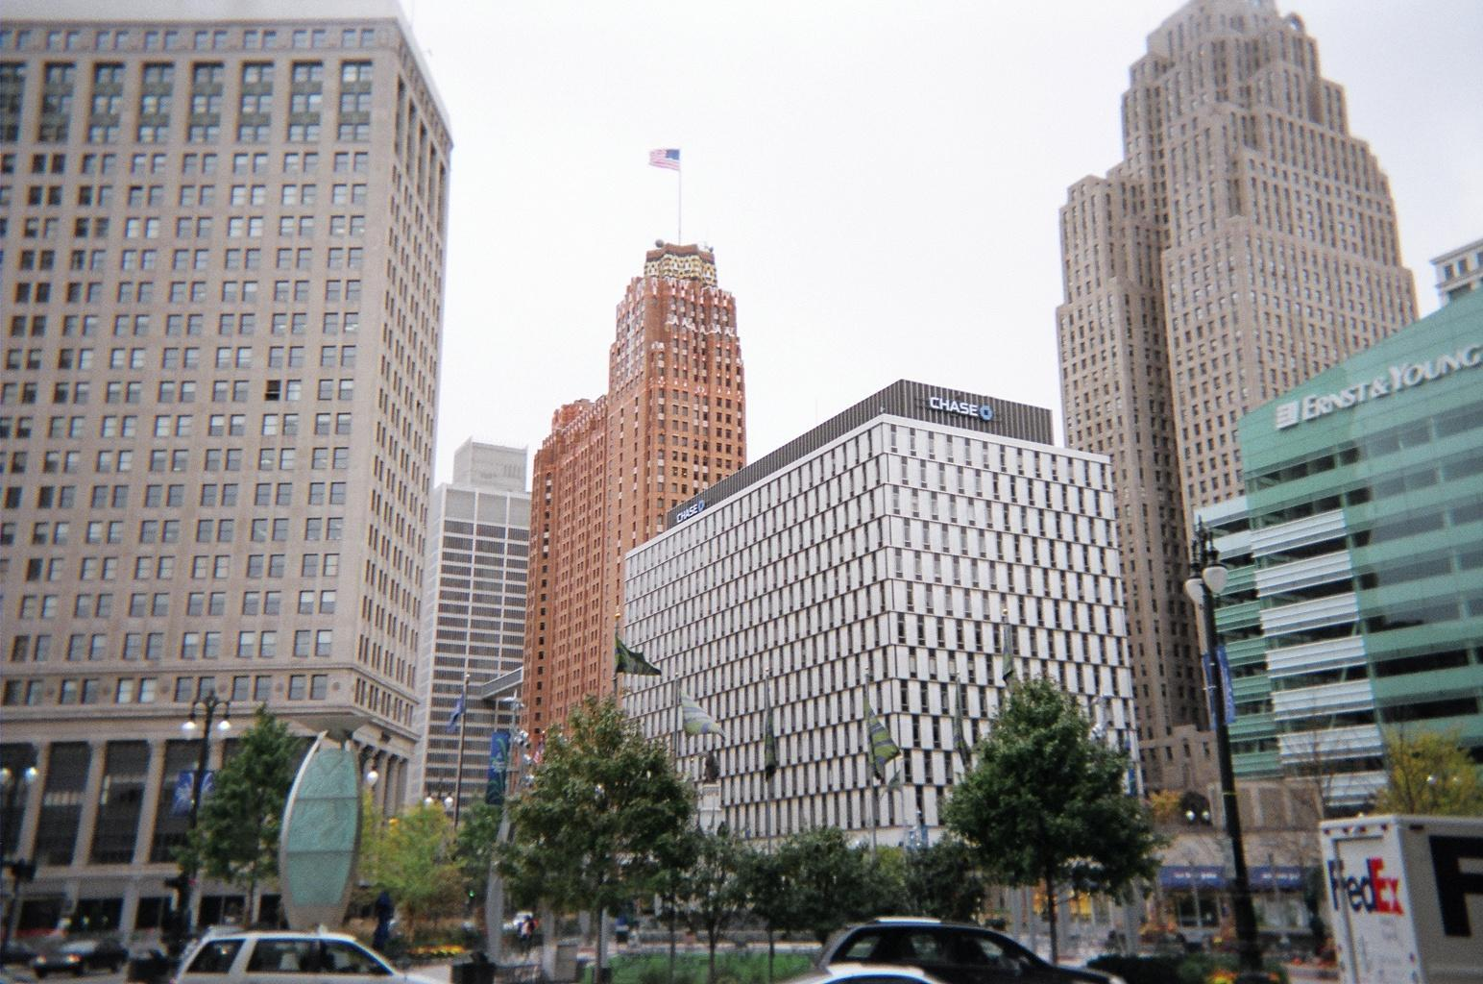
what is remote working?

Slide 9
my remote working history
1994 to 1995 – Worked remotely on a team of 6 or 7. Worked in a silo.

Slide 10
my remote working history
1996 – Sole developer for small, custom dev shop.

Slide 11
my remote working history
1997 to 2000 – Worked on a team of 5. Best team EVER.

Slide 12
my remote working history
2000 to 2001 – Project Director/Team Lead for mid-size consulting firm. Led several project teams.

Slide 13
my remote working history
2001 to early 2006 – Independent consultant – worked mostly alone, but did contribute to a couple project teams during that time.

Slide 14
my remote working history
2006 (roughly 9 months) – Tried my hand at working for “The Man” again. Worked on a small dev team.

Slide 15
my remote working history
2006 to 2014 – Independent consultant. Variety of projects.

Slide 16
my remote working history
November 2014 to Now – Remote team member at Quicken Loans.

Slide 17
remote working
pros
cons
No commute
More time with family/friends
Flexible schedule
More ability to focus
Customized workspace
Miss out on interactions
Self promotion is tougher

Slide 18

convincing your boss

Slide 19

convincing your boss

Slide 20

convincing your boss

Slide 21
tips for remote working
Be present / available
Be disciplined
Have a dedicated space
Use technology to your advantage

Slide 22
tips for remote working
Take advantage of the flexibility

Slide 23
questions?

Slide 24
contact
http://about.me/mjeaton

Slide 25
Image credits
The Chase Building, downtown Detroit – https://commons.wikimedia.org/wiki/File:ChaseBuildingDetroit.JPG

